Slide 1
Housing Market Trends in Relation to Average Family Income
Adam Saenz
Amanda Cantu
Rocio Sampayo
Adolfo Alafa

Slide 2
Project Introduction
Introduction:
Our motivation for this project is to shed light on the economic hardships faced by young Americans, particularly those in the 18 to 25 age group. With economic disparities and the impact of the Covid-19 pandemic, the purchasing power of this segment has weakened, making it challenging to afford homes and build personal wealth. We believe it's crucial to raise awareness about these issues and their implications. In doing so, we may be able to curtail the impact of economic disparities and allow for the segment to begin to prosper.

Slide 3
Project Objective
This project analyzes housing market trends in relation to the average family income, focusing on the challenges faced by young Americans aged 18 to 25. The analysis is based on data sourced from censusdata.gov and is presented through code implementation, data visualization, and a slide deck.
By delving deep into the intricate relationship between housing market dynamics and the average family income, we can extract invaluable insights that serve as navigational tools in this intricate landscape. Our exploration isn't confined to numbers and graphs; it's about providing you with strategic decision-making resources.

Slide 4
Hypothesis
Hypothesis – Population from a lower income bracket, minority groups and age group under 25 years will be at higher risk of not being able to afford a home.
Null hypothesis - Population from a lower income bracket, minority groups and age group under 25 years will be at equal or lower risk of not being able to afford a home.

Slide 5
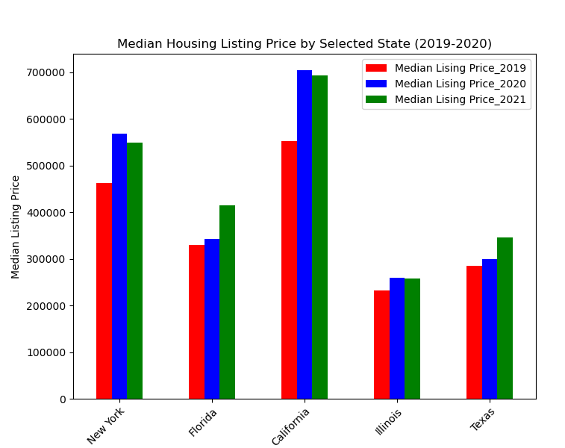
Data Selection and Clean up Process
Data found using the Census with API to find median household income and the housing data was found on realtor.com which provided the data for the median listing prices from 2016 to 2023.
Clean up process:
Reduce housing data to 2019 to 2021
Combined housing to the income data
Graphed out our data by comparing hosing
data to specific demographics

Slide 6
Data Visualization
Housing Price vs. Income: Through intuitive visuals, we've showcased the relationship between housing prices and average family incomes, highlighting the affordability gap.
Trend Over Time: Our visualizations depict how income and housing affordability have evolved from 2019 to 2021, providing valuable insights into the trajectory of the issue.
Comparative Analysis: Visual comparisons between states help identify patterns, enabling us to pinpoint where interventions might have the most impact.
Engaging Stakeholders: Visualizing data empowers stakeholders to grasp the complexities and make informed decisions to address housing affordability.

Slide 7
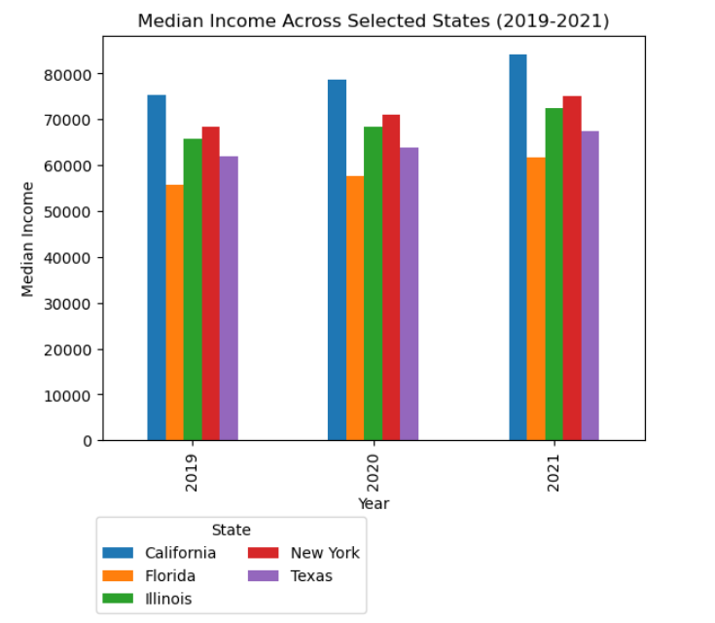
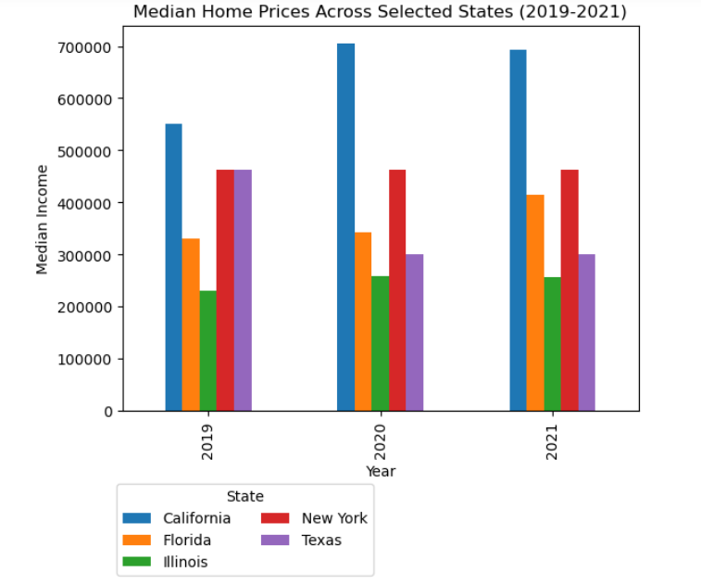
Household Income vs Home Prices

Slide 8
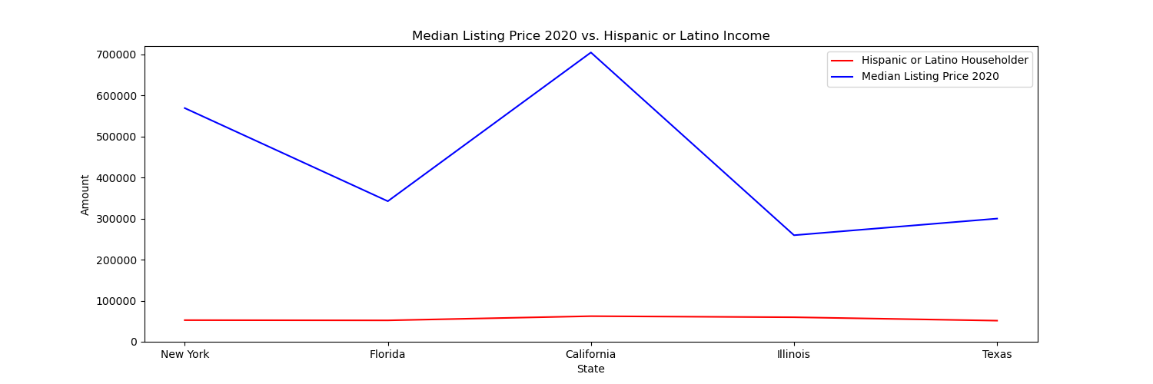
Income Trends
Regional Variability: Our analysis highlights the considerable regional variability in income growth rates. While some areas exhibit steady growth, they are still struggling to keep up with the housing market.
Ethnicity & Generational Specific Insights: Disparities extend to different ethnicities as well generations. Millennials and Baby Boomers as marginalized communities are facing distinct challenges in building and sustaining income levels compared to older generations.
Affordability Dilemma: The rising cost of living and housing expenses is compounding the affordability dilemma. Families are allocating a higher proportion of their income towards housing, impacting their overall financial stability.
Addressing the Gap: JP Morgan's proactive response involves tailoring financial solutions to address income disparities and housing affordability challenges, aligning with our commitment to inclusive financial growth.

Slide 9
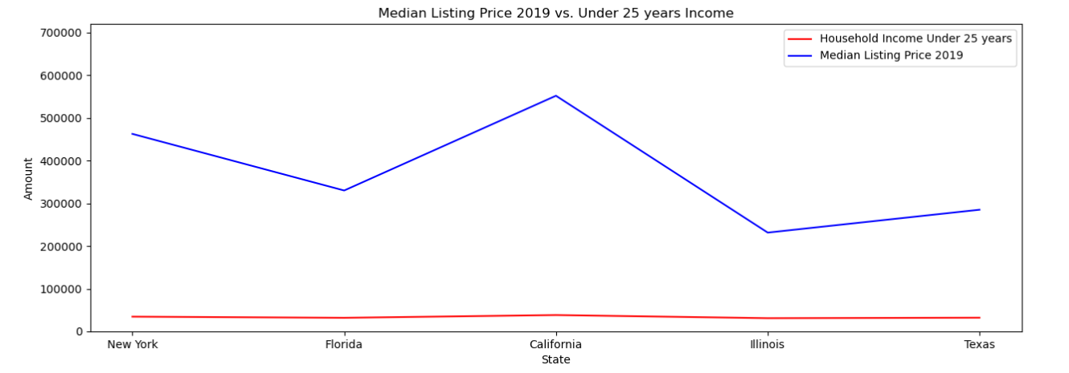
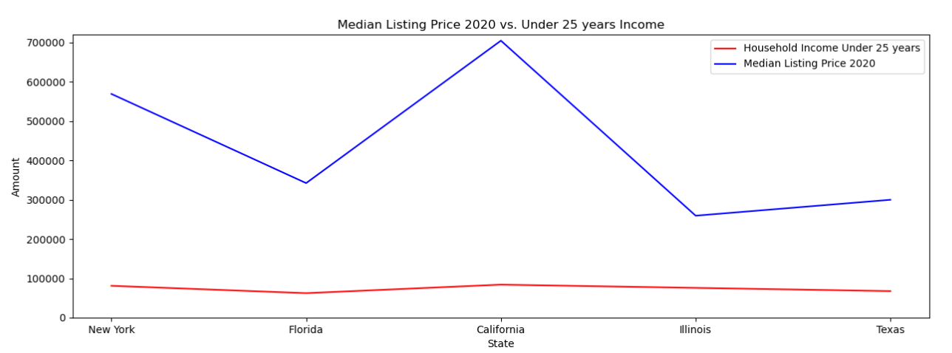
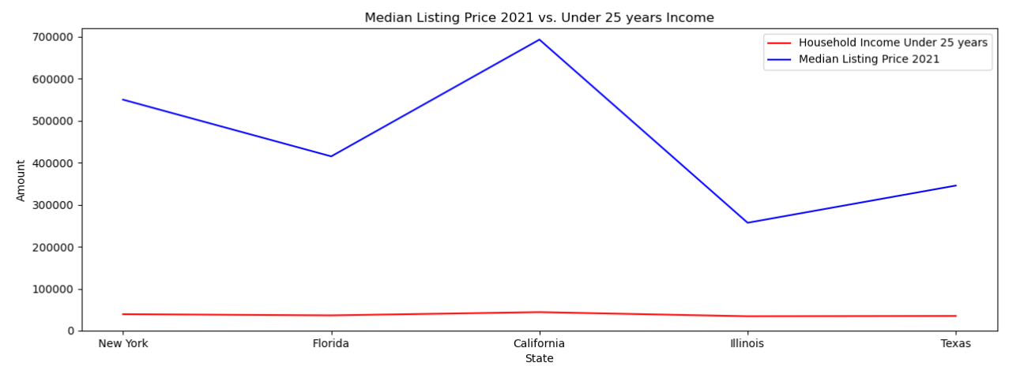
2019 – 2021 Income vs Age

Slide 10


At-Risk Populations
Low-Income Families: Families with lower incomes are particularly vulnerable to housing affordability challenges, facing difficulties in finding suitable housing options within their means.
Millennials, Gen Z & First-Time Buyers: The younger generation, including millennials, often struggle to afford their first homes due to student debt, stagnant wages, and soaring home prices.
Minority Communities: Marginalized communities, including racial and ethnic minorities, often face housing disparities that are exacerbated by income inequalities and systemic barriers.
Urban vs. Suburban Dynamics: At-risk populations in urban areas face different affordability dynamics compared to those in suburban regions due to variations in job opportunities and living costs.
Potential Consequences: Housing insecurity can lead to a range of social and economic consequences, including promoting job growth, providing education and skill development opportunities, and advocating for fair wage policies.

Slide 11
Implications & Solutions
Stagnant Wage Growth: Despite economic growth, wage increases have not kept pace with rising living costs, making it difficult for many families to afford housing.
Rising Income Inequality: The wealth gap has widened over the years, with high-income households benefiting disproportionately from economic gains.
Impact of COVID-19: The pandemic has further exacerbated income disparities, with job losses and reduced work hours affecting lower-income individuals more severely.
Regional Disparities: Income levels vary significantly across regions, contributing to varying housing affordability challenges in different areas.
Potential Solutions: Addressing income disparities requires comprehensive strategies, including promoting job growth, providing education and skill development opportunities, and advocating for fair wage policies.

Slide 12
Key Findings
Income-Home Price Gap: The gap between income growth and rising home prices has widened significantly, particularly in high-demand areas like California and New York.
Demographic Implications: Income disparities are impacting diverse demographics, including low- and middle-income families, millennials, and marginalized communities.
Regional Variation: Our data shows that income trends and housing affordability challenges vary substantially between states, with Florida and Texas displaying more favorable income-to-home-price ratios.
Investment Opportunities: Despite challenges, opportunities for targeted real estate investments exist, especially in regions with positive income growth trajectories and favorable affordability ratios.

Slide 13



Conclusion
This project aims to raise awareness about the economic disparities young Americans encounter in the housing market. By presenting concrete data and insights, we hope to contribute to the ongoing dialogue about economic challenges faced by the 18 to 25 age group.

